Slide 1
Accounting Principles
7th Edition
Weygandt • Kieso • Kimmel
Chapter 20
Managerial Accounting
Prepared by Naomi Karolinski
Monroe Community College
and
Marianne Bradford
Bryant College
John Wiley & Sons, Inc. © 2005

Slide 2
CHAPTER 20 MANAGERIAL ACCOUNTING
After studying this chapter, you should be able to:
Explain the distinguishing features of managerial accounting.
Identify the three broad functions of management.
Define the three classes of manufacturing costs.
Distinguish between product and period costs.
Explain the difference between a merchandising and a manufacturing income statement.

Slide 3

CHAPTER 20 MANAGERIAL ACCOUNTING
After studying this chapter, you should be able to:
Indicate how cost of goods manufactured is determined.
Explain the difference between a merchandising and a manufacturing balance sheet.

Slide 4
MANAGERIAL ACCOUNTING
BASICS
STUDY OBJECTIVE 1
Management Accounting
  A field of accounting that provides economic and financial information for managers and other internal users.

Slide 5
MANAGERIAL ACCOUNTING BASICS
Activities include:
Explaining manufacturing and nonmanufacturing costs and how they are reported in the financial statements
Computing the cost of providing a service or manufacturing a product
Determining the behavior of costs and expenses as activity levels change
Analyzing cost-volume profit relationships within a company
Notes:
3

Slide 6
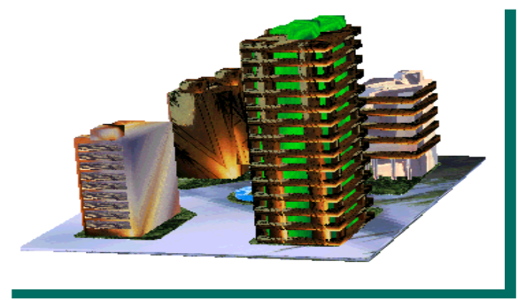
MANAGERIAL ACCOUNTING
BASICS
Activities include (continued):
Assisting management in profit planning and budgeting
Providing a basis for controlling costs and expenses by comparing actual results with planned objectives and standard costs
Accumulating and presenting relevant data for management decision making

Slide 7
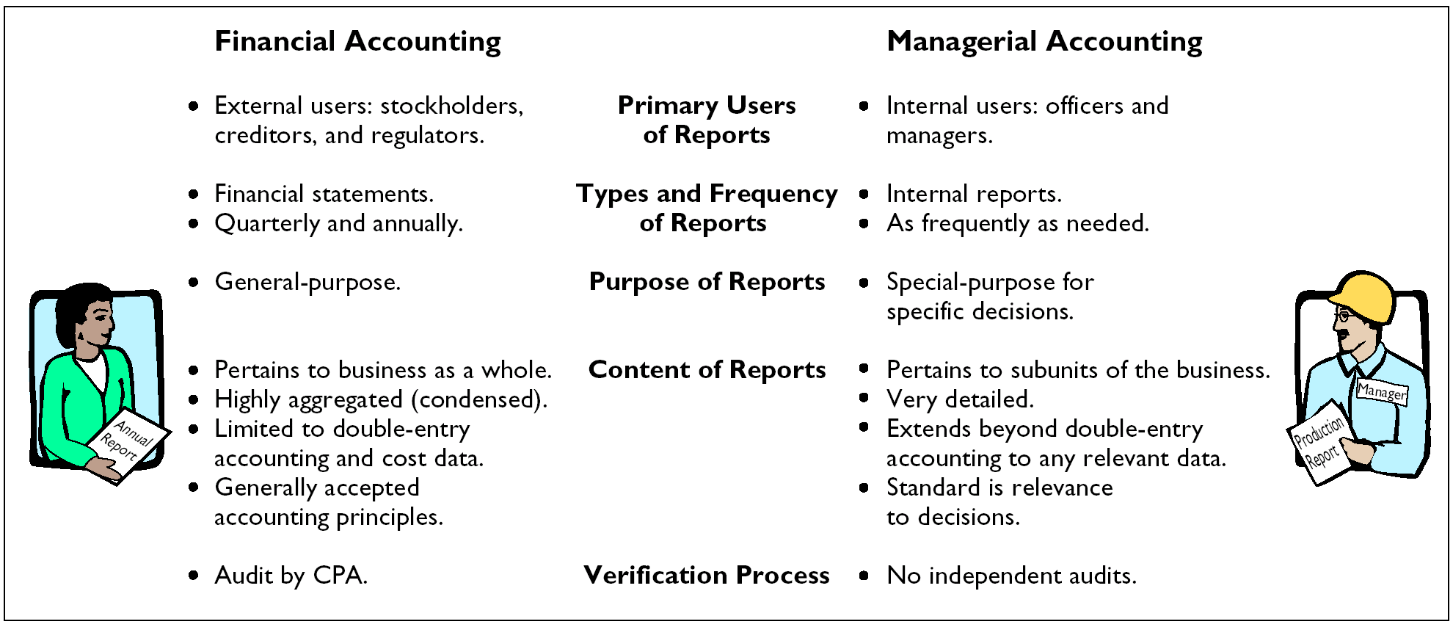
COMPARING MANAGERIAL AND FINANCIAL ACCOUNTING

Slide 8
ETHICAL STANDARDS FOR MANAGERIAL ACCOUNTANTS
Managerial Accountants have an ethical obligation to their companies and the public.
The Institute of Management Accountants (IMA) developed a code of ethical standards which divides the managerial accountant’s responsibilities into 4 areas:
    Competence
    Confidentiality
    Integrity
    Objectivity
Notes:
5

Slide 9
MANAGEMENT FUNCTIONS
STUDY OBJECTIVE 2
Planning
Motivating and Directing
Controlling
Notes:
6

Slide 10
PLANNING
Planning requires management to:
Look ahead
Establish objectives
Add value to the business under its control (as measured by company’s stock price or its potential selling price)
Notes:
7

Slide 11
DIRECTING AND MOTIVATING
Directing and Motivating requires management to:
Coordinate a company’s activities
Implement planned objectives
Select and train employees
Prepare organization charts
Notes:
7

Slide 12
CONTROLLING
Controlling requires management to:
Keep the firm’s activities on track
Determine whether planned goals are being met
Decide what changes are needed if goals are not met

Slide 13
MANAGERIAL
COST CONCEPTS
Managers need information related to costs, such as:
What costs are involved in making the product or providing a service?
If production volume is decreased, will costs decrease?
What impact will automation have on total costs?
How can costs best be controlled?
Notes:
9

Slide 14
MANAGERIAL
COST CONCEPTS
Manufacturing: Activities and processes that convert raw materials into finished goods.
Manufacturing Costs include:
  Direct materials
  Direct labor
  Manufacturing overhead

Slide 15
Managerial accounting:
a. is governed by generally accepted accounting principles.
b. places emphasis on special-purpose information.
c. pertains to the entity as a whole and is highly aggregated.
d. is limited to cost data.
Chapter 20

Slide 16
Managerial accounting:
a. is governed by generally accepted accounting principles.
b. places emphasis on special-purpose information.
c. pertains to the entity as a whole and is highly aggregated.
d. is limited to cost data.
Chapter 20

Slide 17
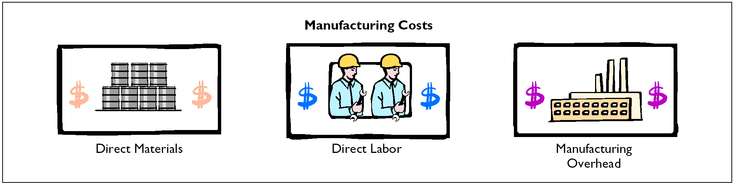
CLASSIFICATIONS OF MANUFACTURING COSTS
STUDY OBJECTIVE 3

Slide 18
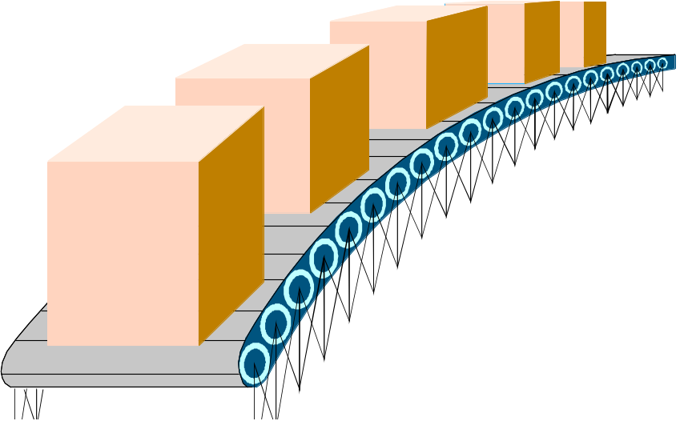
MANUFACTURING COSTS DIRECT MATERIALS
Raw materials
  The basic materials and parts that are used in the manufacturing process
  Raw materials physically and directly associated with the finished product are called direct materials
Materials
Notes:
17

Slide 19
INDIRECT MATERIALS
Indirect Materials are raw materials which cannot be easily associated with the finished product.
• Not physically part of the finished product
• Cannot be traced because their physical association with the finished product is too small in terms of cost
Accounted for as part of Manufacturing Overhead

Slide 20

LABOR
Direct Labor: The work of factory employees which is physically and directly associated with converting raw materials into finished goods.
Indirect Labor: Efforts which have no physical association with the finished product or it’s impractical to trace the costs.
Indirect Labor: Classified as Manufacturing Overhead
Factory Labor

Slide 21
MANUFACTURING OVERHEAD
Consists of costs that are indirectly associated with manufacturing the finished product.
Includes:
    • Indirect materials
• Indirect labor
• Depreciation on factory buildings and machines
• Insurance, taxes, maintenance on factory facilities
Manufacturing Overhead

Slide 22
PRODUCT COSTS VERSUS PERIOD COSTS
STUDY OBJECTIVE 4
Product costs:
  include each of the manufacturing cost elements (direct materials, direct labor, and manufacturing overhead)
  are a necessary and integral part of producing the finished product
  are recorded as inventory and not expensed to cost of goods sold until the time of sale

Slide 23
PRODUCT COSTS VERSUS PERIOD COSTS
Period costs:
are identifiable with a specific time period
are nonmanufacturing costs
are not included in inventory
include selling and administrative expenses
are deducted from revenues in the period incurred

Slide 24


PRODUCT VERSUS PERIOD COSTS
Product Costs
{
Direct Materials
Manufacturing Costs
Direct Labor
Manufacturing Overhead
Period Costs
{
Selling Expenses
Nonmanufacturing Costs
Administrative Expenses

Slide 25
Merchandising versus Manufacturing Income Statement
STUDY OBJECTIVE 5
The income statement for a manufacturer is similar to that of a merchandiser except the cost of goods sold section.

Slide 26
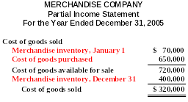
COST OF GOODS SOLD SECTION OF A MERCHANDISING COMPANY
The cost of goods sold sections for merchandising company includes cost of goods purchased:

Slide 27
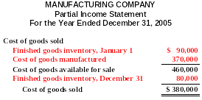
COST OF GOODS SOLD SECTION OF A MANUFACTURING COMPANY
The cost of goods sold sections for manufacturing company includes cost of goods manufactured:

Slide 28




COST OF GOODS SOLD COMPONENTS
Merchandiser
Beginning Merchandise Inventory
Ending Merchandise Inventory
+
Cost of Goods Purchased
-
=
Manufacturer
Cost of Goods Sold
Beginning Finished Goods Inventory
Ending Finished Goods Inventory
+
Cost of Goods Manufactured
-
=

Slide 29
COST OF GOODS MANUFACTURED
FORMULA
STUDY OBJECTIVE 6
Beginning Work in Process Inventory
Total Current Manufacturing Costs
Total Cost of Work in Process
+
=
Total Cost of Work in Process
-
Ending Work in Process Inventory
Cost of Goods Manufactured
=
Notes:
12

Slide 30
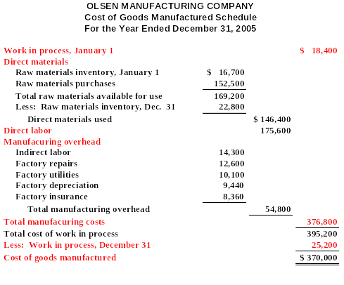
COST OF GOODS MANUFACTURED SCHEDULE
The Cost of Goods Manufactured Schedule – as shown on the right is an internal financial schedule that shows each of the cost elements.
Notes:
13

Slide 31
The sum of the direct materials costs, direct labor costs, and manufacturing overhead incurred is the:
a. cost of goods manufactured.
b. total manufacturing overhead.
c. total manufacturing costs.
d. total cost of work in process.
Chapter 20

Slide 32
The sum of the direct materials costs, direct labor costs, and manufacturing overhead incurred is the:
a. cost of goods manufactured.
b. total manufacturing overhead.
c. total manufacturing costs.
d. total cost of work in process.
Chapter 20

Slide 33
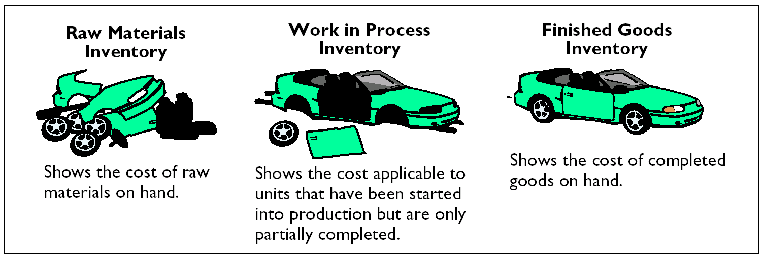
CURRENT ASSETS SECTIONS
MERCHANDISING AND MANUFACTURING BALANCE SHEETS
STUDY OBJECTIVE 7
Merchandiser
  One inventory category
Manufacturer
  Three inventory accounts:
    Finished Goods Inventory
    Work in Process Inventory
    Raw Materials Inventory
Notes:
14

Slide 34
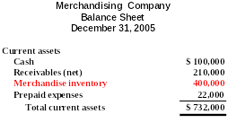



CURRENT ASSETS SECTIONS OF MERCHANDISING AND MANUFACTURING BALANCE SHEETS

Slide 35
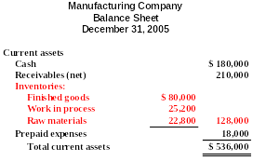


CURRENT ASSETS SECTIONS OF MERCHANDISING AND MANUFACTURING BALANCE SHEETS

Slide 36
ASSIGNMENT OF COSTS TO COST CATEGORIES
The manufacturing and selling costs can be assigned to the various categories shown below.
Product Costs
Direct
Direct
Manufacturing
Period
Cost Item
Materials
Labor
Overhead
Costs
1. Material cost ($10 per door)
X
2. Labor costs ($8 per door)
X
3. Depreciation on new equipment
($25,000 per year)
X
4. Property taxes ($6,000 per year)
X
5. Advertising costs ($30,000 per year)
X
6. Sales commissions ($4 per door)
X
7. Maintenance salaries ($28,000 per
year)
X
8. Salary of plant manager ($70,000)
X
9. Cost of shipping pre-hung doors
($12 per door)
X

Slide 37
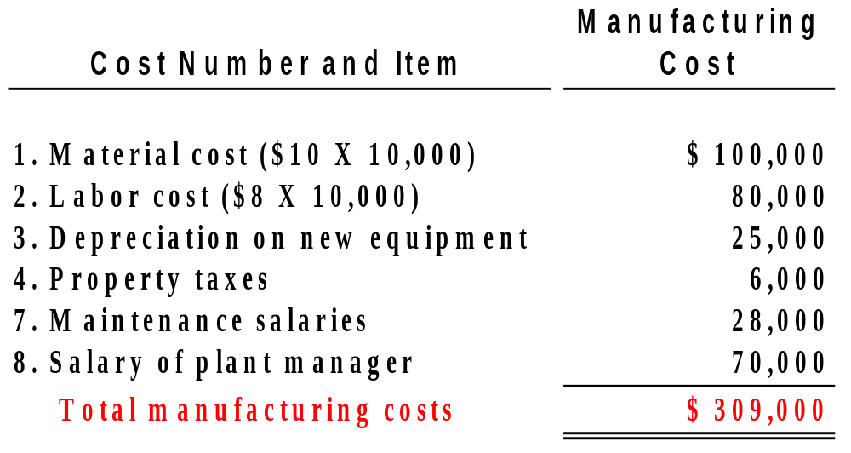
COMPUTATION OF TOTAL MANUFACTURING COSTS
Total manufacturing costs are the sum of the product costs – direct materials, direct labor, and manufacturing overhead costs. Northridge Company produces 10,000 pre-hung wooden doors the first year. The total manufacturing costs are:
Notes:
15

Slide 38

CONTEMPORARY DEVELOPMENTS IN MANAGERIAL ACCOUNTING
Contemporary business managers demand different and better information than they needed just a few years ago. Managerial accountants will need to address:
  Service industry trends
  Value chain management

Slide 39
SERVICE INDUSTRY TRENDS
Managers of service companies look to managerial accountants to answer questions such as:
  Transportation: Service a new route?
  Package delivery services: What fee structure to use?
  Telecommunications: Invest in a new satellite?
  Professional services: How productive are staff members?
  Financial institutions: Build a new branch?
  Health Care: Invest in new equipment?

Slide 40
VALUE CHAIN MANAGEMENT
Value chain consists of all activities associated with providing a product or service
Each activity must add value to the product or service and include:
  Research and development
  Ordering raw materials
  Manufacturing
  Marketing
  Delivery
  Customer relations
Supply chain consists of all activities from receipt of an order to product or service delivery

Slide 41

VALUE CHAIN AND SUPPLY CHAIN MANAGEMENT
Managing the value chain and supply chain requires:
  Technological changes such as enterprise resource planning (ERP) to centralize and integrate information
  Just-in-time inventory methods to deliver goods just in time for use, lowering inventory costs

Slide 42
VALUE CHAIN AND SUPPLY CHAIN MANAGEMENT
Managing the value chain and supply chain requires (continued):
  Total Quality Management (TQM) to reduce defects in finished products
  Activity Based Costing (ABC) to focus on activities that produce costs, and to then scrutinize and control those costs

Slide 43

COPYRIGHT
Copyright © 2005 John Wiley & Sons, Inc. All rights reserved. Reproduction or translation of this work beyond that permitted in Section 117 of the 1976 United States Copyright Act without the express written consent of the copyright owner is unlawful. Request for further information should be addressed to the Permissions Department, John Wiley & Sons, Inc. The purchaser may make back-up copies for his/her own use only and not for distribution or resale. The Publisher assumes no responsibility for errors, omissions, or damages, caused by the use of these programs or from the use of the information contained herein.

